Slide 1
Lecture 8: Classifiers II
Intro to Data Science for Public Policy
Spring 2017
Jeff Chen + Dan Hammer

Slide 2
Roadmap
Homework #2
How to think about applying data science
Logistic Regression
<break>
Support Vector Machines
Neural Networks (if we have time)
Homework assignment
Intro to Data Science for Public Policy, Spring 2017

Slide 3
Homework #2: Scores
Scores | Tabulation | Proportion
7 | 2 | 8.3%
8 | 3 | 12.5%
9 | 6 | 25.0%
10 | 13 | 54.2%
Homework #2

Slide 4
MAPE
Mean MAPE = 1.44%
Best score = 0.59%
Homework #2:
Performance
Ran without Error
Run time vs. MAPE
Mean = 17s
Max = 274s
Homework #2

Slide 5
Homework #2: Agreement
GEOID | MSA | Cnt | % of Class
48660 | Wichita Falls, TX (Metro Area) | 15 | 63%
27980 | Kahului-Wailuku, HI (Micro Area) | 12 | 50%
10780 | Alexandria, LA (Metro Area) | 10 | 42%
35380 | New Orleans-Metairie-Kenner, LA (Metro Area) | 9 | 38%
17980 | Columbus, GA-AL (Metro Area) | 8 | 33%
19100 | Dallas-Fort Worth-Arlington, TX (Metro Area) | 8 | 33%
29860 | Laurel, MS (Micro Area) | 8 | 33%
46980 | Vicksburg, MS (Micro Area) | 8 | 33%
Homework #2

Slide 6
Homework #2: Why Did We Do This?
Focus on the technique of dividing data and scoring
Develop skill in testing models at scale
Homework #2

Slide 7
Roadmap
Homework #2
Pause to think about applying types of data analytics
Logistic Regression
<break>
Support Vector Machines
Neural Networks (if we have time)
Homework assignment
Intro to Data Science for Public Policy, Spring 2017

Slide 8
descriptive analytics
using data to describe what happened in the past
explanatory analytics
using data and statistical methods to test a hypothesis pertaining to a theory
predictive analytics
using data to predictive the future
prescriptive analytics
using predictions to drive specific targeted actions
types of analytics
Application

Slide 9
Analytics in this context refers to data analysis and science.
Note that in tech industry, web development, and marketing, analytics often refers to web analytics (e.g. click, views, buys).
Application

Slide 10
summary stats from car sensors
Descriptive.
tests that indicate the existence of relationships among sensors
Explanatory.
the algorithms that predicts relationships
Predictive.
driverless car that can sense danger, navigate, and drive using predictions
Prescriptive.
Driverless car example
Application

Slide 11
summary stats of fires by building type
Descriptive.
logistic model -- odds ratios tell stories
Explanatory.
random forest and SVM to produce low error, reliable predictions
Predictive.
predictions used to auto-schedule risk-based inspections
Prescriptive.
Firefighting example
Application

Slide 12
mean, median, standard deviation
Descriptive. simple measures and cross tab to provide context
hypothesis tests, QED, evaluations
Explanatory. Testing if phenomena exist, find a relationship, tell a story.
low-error models, algorithms
Predictive. Machine learning techniques to reliably anticipate and replicate phenomena
policies, auto-behavior
Prescriptive. Software integration, new policies, standard operating protocols that use predictions to make automated decisions
tools and techniques
Application

Slide 13
Lectures 1 to 3
Descriptive. simple measures and cross tab to provide context
Lecture 4, most of quant. econ.
Explanatory. Testing if phenomena exist, focus on finding a relationship, not a prediction.
Lectures 5 to 9
Predictive. Machine learning techniques to reliably anticipate and replicate phenomena
Lectures 10 to 13
Prescriptive. Software integration and standard operating protocols that use predictions to make automated decisions
How it maps to our class
Application

Slide 14
Where does experimental design play into this?
How about feature selection?
How predictive accuracy?
How about interpreting coefficients?
How about application of the models?
Application

Slide 15
descriptive analytics
using data to describe what happened in the past
explanatory analytics
using data and statistical methods to test a hypothesis pertaining to a theory
predictive analytics
using data to predictive the future
prescriptive analytics
using predictions to drive specific targeted actions
How about interpreting coefficients?
Where does experiment design play into this?
How about feature selection?
How predictive accuracy?
Application

Slide 16
How do we interpret results of other model types if there aren’t linear coefficients?
Context. Note that prediction models might not be the same model used for explanation.
Marginal effects (like in regression): Score a set of data where all features except one are held at the mean or mode. The one feature that is held out will illustrate relative effects.
Accuracy benchmarks in public policy will translate into people and dollars. 1% regression error can mean $1 billion. 1% in TPR may be 10 people.
Application

Slide 17
How do we choose variables?
Depends on your field, depends on your goal
Regularization is a statistical technique of finding variables among a pool of variables with the greatest signal and penalizing unrelated variables. Good for prediction.
Social science frameworks start from a theory to focus on a takeaway. Good for comms.
Application

Slide 18
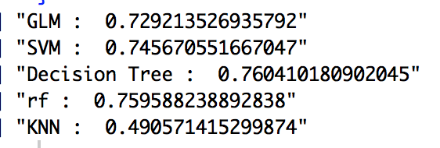
Why should I use non-linear methods?
Many times, non-linear methods can capture more of the signal.
Application

Slide 19
Most academics and practitioners conflate explanatory, predictive and prescriptive. There isn’t much discussion or distinction as few outside of tech industry have implemented prescriptive systems.
Application

Slide 20
Never use simple descriptive or explanatory analytics for prescriptive tasks. Prescriptive analytics requires reliable predictions.
Application

Slide 21
Remember, just cause your odds ratio in a logistic regression is statistically significant does not mean you can predict a phenomenon.
Application

Slide 22
Predictive Analytics only works if the paradigm of the past continues into the future.
Application

Slide 23
And this is how I feel when policymakers choose to use descriptive analytics rather than letting the process run its course –
No! What are you doing?!
Application

Slide 24
Roadmap
Homework #2
Pause to think about applying types of data analytics
Logistic Regression
<break>
Support Vector Machines
Neural Networks (if we have time)
Homework assignment
Intro to Data Science for Public Policy, Spring 2017

Slide 25
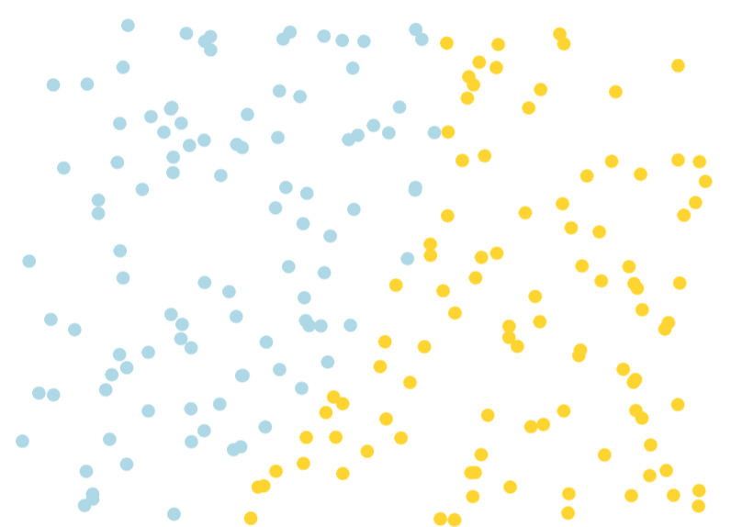
Two classes,
two input features
z = 1
z = 0
Logistic Regression

Slide 26
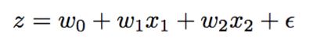
There’s probably a simple linear equation that can be used to separate the two class
Logistic Regression

Slide 27
1
But wait, there’s a problem. What is the problem?
0
Logistic Regression

Slide 28
1
Output is not bound between 0 and 1
This result is not interpretable
0
Logistic Regression

Slide 29
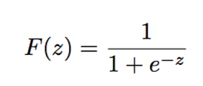
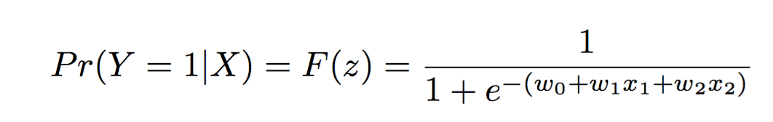
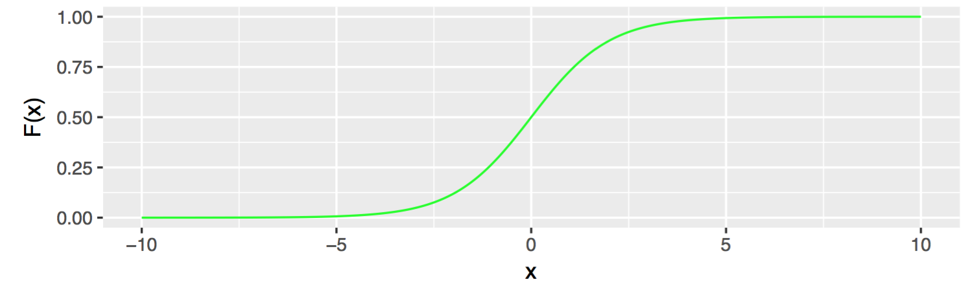
Solution:
Plug into to get
Logistic Regression

Slide 30
What does this sigmoid function do?
Logistic Regression

Slide 31
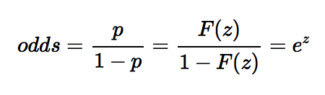
As this is a linear function,
we should be able to interpret the coefficients.
To do so we first define odds (success p divided by failure):
Logistic Regression

Slide 32
The odds ratio compares two sets of odds where one set examines the case where X = 1 and X = 0.
What’s the difference in odds at these two positions
Logistic Regression

Slide 33
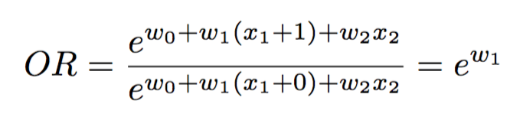
Which can be expressed in terms of the following:
In other words: Just exponentiate the coefficient.
Logistic Regression

Slide 34
Interpretation
OR = 0.9 = 10% less likely
OR = 4 = 300% more likely or 4x higher chance
OR = 0.1 = 90% less likely
OR = 1 = No significant difference
Logistic Regression

Slide 35
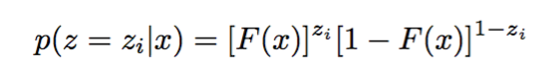
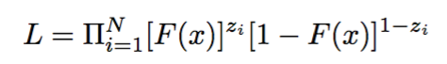
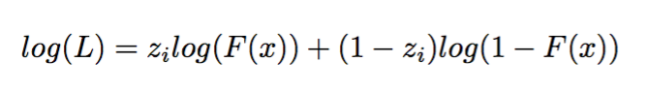
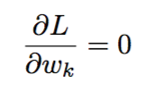
Logistic regression is optimized using Maximum Likelihood Estimation (MLE)
Single likelihood
Likelihood
(Product of all obs)
Log-Likelihood
(Log transformed as exponents are hard)
Solve: Partial derivative of L with respect to w = 0
Logistic Regression

Slide 36
Assumptions
The usual suspects: Independence of error terms, extraneous variables are omitted, etc.
Records should not be perfectly separable.
Sample sizes need to be large for each target class (MLE is weak if targets are small). Minimum of 30 to 40 cases per parameter estimated.
Tuning is largely a matter of feature selection: it all depends on the variables that are available.
Logistic Regression

Slide 37
The Good, The Bad and The Ugly
Good
The technique is well-suited for socializing an empirical problem.
Method of choice for binary problems in economics, sociology and public policy, and applied medical.
Bad
Often is outperformed in accuracy by more flexible techniques such as Random Forests.
Limited to linear assumptions. Weak with non-linear problems
Use tends to be pone to high bias (bias-variance tradeoff)
Ugly
None unless the technique is misused.
Logistic Regression

Slide 38
Common uses
Medical: Relative risks of medicine use
Economics: Choice models for transport
Politics: Chance of demographic leaning in one direction
Program evaluation: Estimated program effect
Logistic Regression

Slide 39
<Code Time/>
Logistic Regression

Slide 40
Roadmap
Homework #2
Pause to think about applying types of data analytics
Logistic Regression
<break>
Support Vector Machines
Neural Networks (if we have time)
Homework assignment
Intro to Data Science for Public Policy, Spring 2017

Slide 41
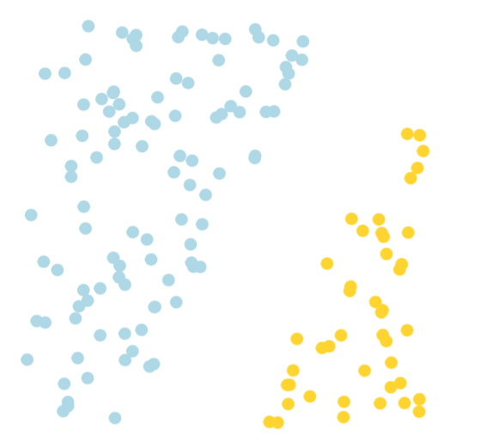
Let’s assume a modified case where we have two classes that are separated by a gap.
SVMs

Slide 42
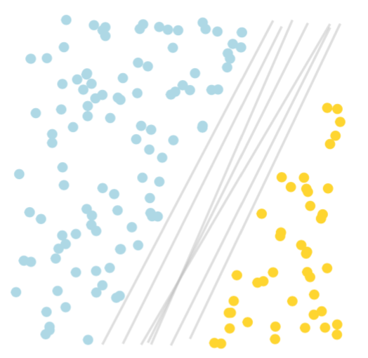
There should be some line that can separate the classes. But which?
SVMs

Slide 43
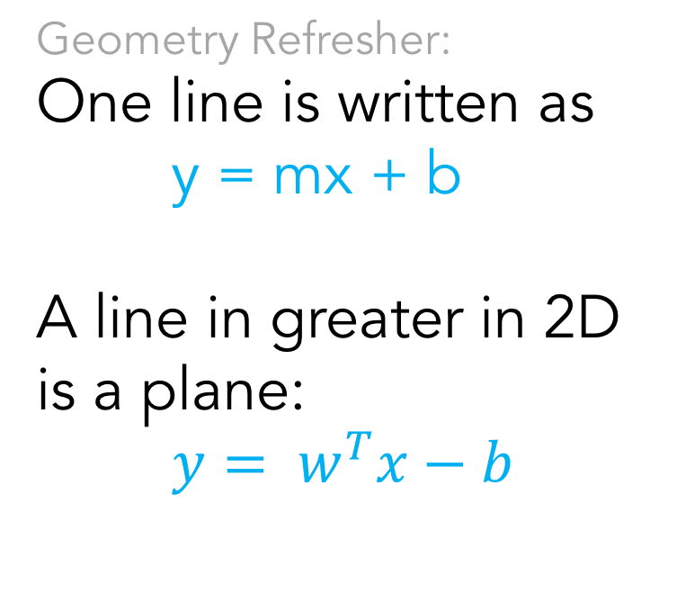
Geometry Refresher:
One line is written as
y = mx + b
A line in greater in 2D is a plane:
$y= w^{T}x−b$
SVMs

Slide 44
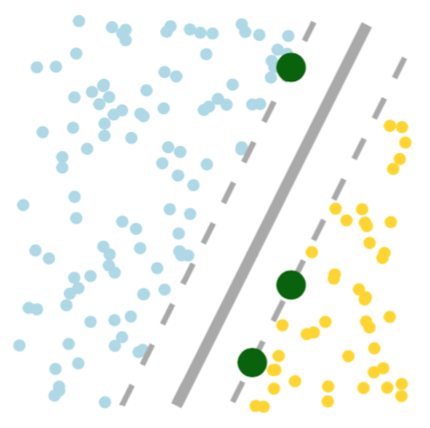
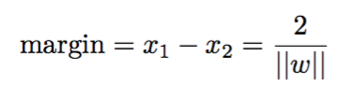
Goal:
Maximize the distance between each class. Gap is known as the margin
SVMs

Slide 45
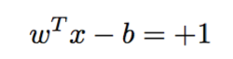
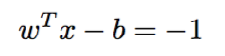
How:
Find hyperplanes that sit on the edge of each group
Note that points may not sit in the margin.
SVMs

Slide 46
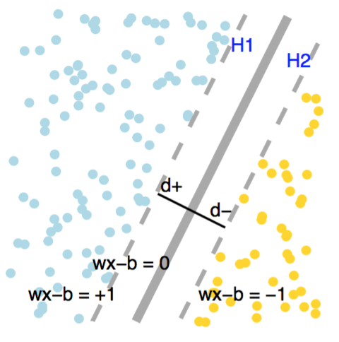
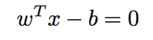
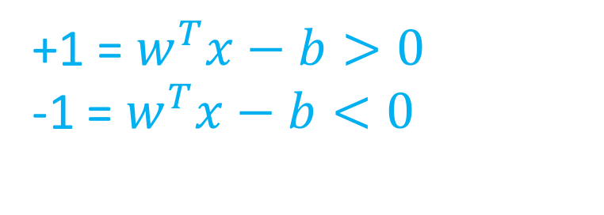
The decision plane is given by the plane that is equidistant from the two decision planes.
Where the decision criteria are:
+1 = $w^{T}x−b>0$
-1 = $w^{T}x−b<0$
SVMs

Slide 47
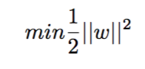
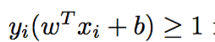
We find the optimal hyperplanes by maximizing the margin
But it is easier to minimize this transformed version of distance using quadratic programming.
s.t.
Sometimes the ½ is dropped as it’s a constant.
SVMs

Slide 48
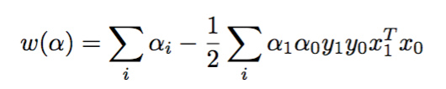
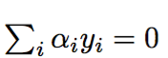
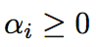
The value of w is learned as a function of alpha.
Subject to
“Linear Discriminant” Dot Product
Or Sum of the Products
This is key for modifying the shape of hyperplane.
Alpha is determined through convex optimization
SVMs
Notes:
The equation is the sum of all points i minus the product of alphas, labels, values. α are parameters that are being tuned in order to maximize w.”

Slide 49
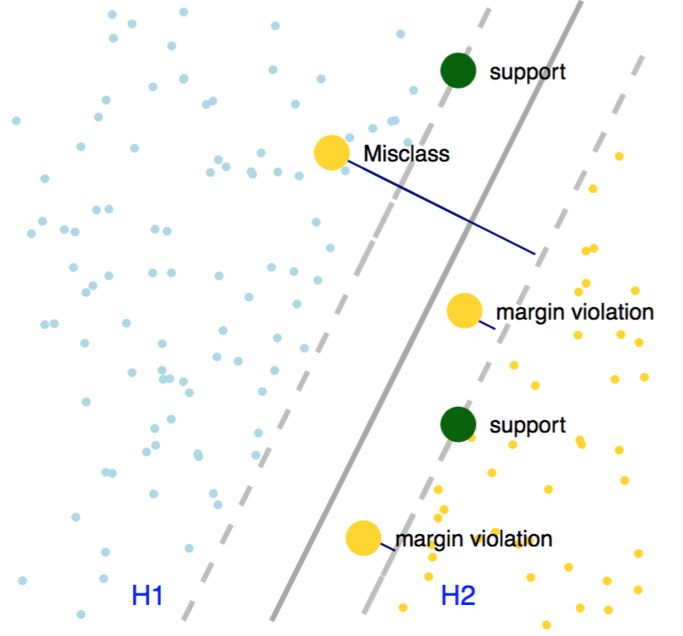
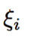
Honest truth: Most problems don’t have clear margins (e.g. hard margin). Most data have ’soft margins’
Slack variables are a measure of how far misclassified points and margin violation points are from the correct hyperplane.
“How much error can the model take?”
SVMs

Slide 50
In terms of ||w||, what values do slack values take on if:
margin violation
misclassification
SVMs

Slide 51
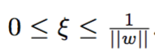
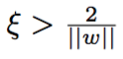
In terms of ||w||, what values do slack values take on if:
margin violation
misclassification
SVMs

Slide 52
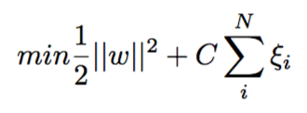
Slack variables enter into the optimization equation as part of a cost “penalty” – also known as regularization.
C is a hyperparameter used to tune how much ”slack” is given when determining the margin.
SVMs

Slide 53
How is C determined?
What does C mean if it’s large?
SVMs
Notes:
C is cross validated along a grid as it’s not a learned parameter, usually on an exponential scale base 10 (10^-1, 10^1)
Large C means smaller margin – slack matters more
Small C means larger margin – slack is ignored

Slide 54
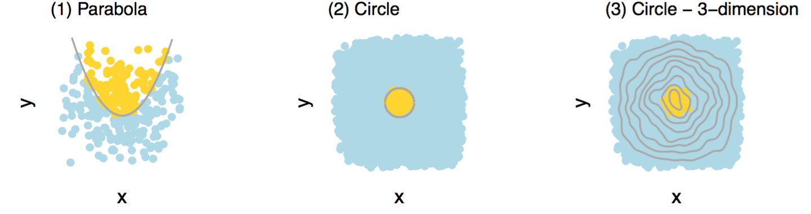
These problems cannot be solved using linear models.
SVMs

Slide 55
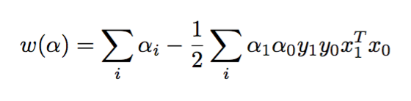
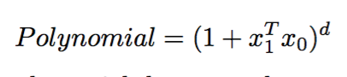
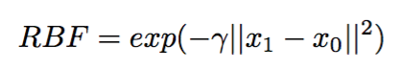
The linear dot product can be swapped out for other non-linear relationships to take advantage of curvature and transformations in multiple dimensions.
SVMs

Slide 56
Video!
https://www.youtube.com/watch?v=3liCbRZPrZA
SVMs

Slide 57
The Good, The Bad and The Ugly
Good
Very strong at handling non-linear problems
Great for problems without a simple explanation (e.g. images classification, text classification, genetics, health research)
Not sensitive to multicollinearity issues
Bad
Takes a long time to train in high dimensional space
Simple explanation is not possible as problem is formulated as a geometric one
Deriving probabilities may at times require fancy footwork
Ugly
None unless the technique is misused.
SVMs

Slide 58
Common uses
Pattern recognition in images:
Image recognition and retrieval
Facial expression recognition
Biology:
Gene expression in high dimensional spaces
Detecting protein folds
Text:
Classification of topics
Personalized content for e-learning and social media
SVMs

Slide 59
<Code Time/>
SVMs

Slide 60
Roadmap
Homework #2
Pause to think about applying types of data analytics
Logistic Regression
<break>
Support Vector Machines
Neural Networks (if we have time)
Homework assignment
Intro to Data Science for Public Policy, Spring 2017

Slide 61
ANNs
Notes:
The brain stores a lot of memory. The basic unit is the neuron. About 100 billion neurons per brain

Slide 62
ANNs
Notes:
Impulses move from neuron to neuron, passing information such as memories or reactions. Neurons fire in multiple directions with signals jumping from neuron to neuron.

Slide 63
ANNs
Notes:
Such that signal must jump across cells at the synapse. The signal has to be sufficiently high to register.

Slide 64
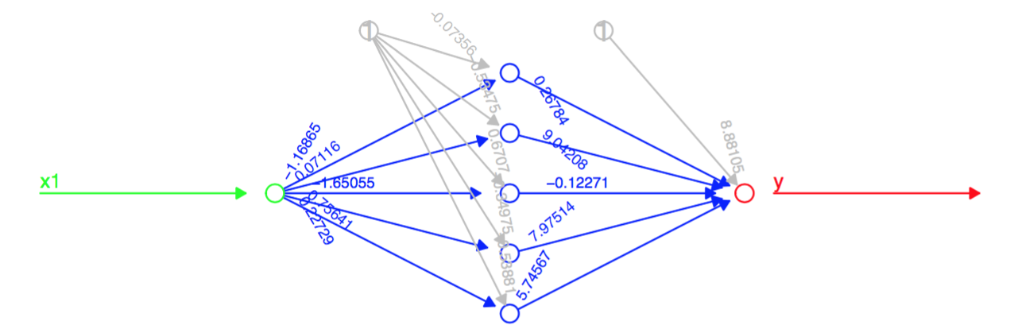
y = f(x1)
intercepts
input
output
hidden layer = controls non-linearity
each node
ANNs
Notes:
Such that signal must jump across cells at the synapse. The signal has to be sufficiently high to register.

Slide 65
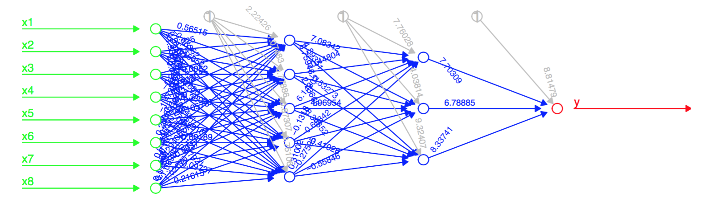
y = f(x1, x2, x3, x4, x5, x6, x7, x8)
ANNs
Notes:
Such that signal must jump across cells at the synapse. The signal has to be sufficiently high to register.

Slide 66
Artificial Neural Networks are the basis of “Deep Learning”.
ANNs
Notes:
Such that signal must jump across cells at the synapse. The signal has to be sufficiently high to register.

Slide 67
The Good, The Bad and The Ugly
Good
Handles large number of features
Captures non-linear relationships
Strong performer with missing values
Used to learn complex patterns
Bad
Enormous data requirements
Data requirements grow following a quadratic with each additional node
Computationally expensive and time consuming
Ugly
Requires enormous amounts of data
Determining node and layer architecture is very challenging
SVMs

Slide 68
Roadmap
Homework #2
Pause to think about applying types of data analytics
Logistic Regression
<break>
Support Vector Machines
Neural Networks (if we have time)
Homework assignment
Intro to Data Science for Public Policy, Spring 2017

